Slide 1
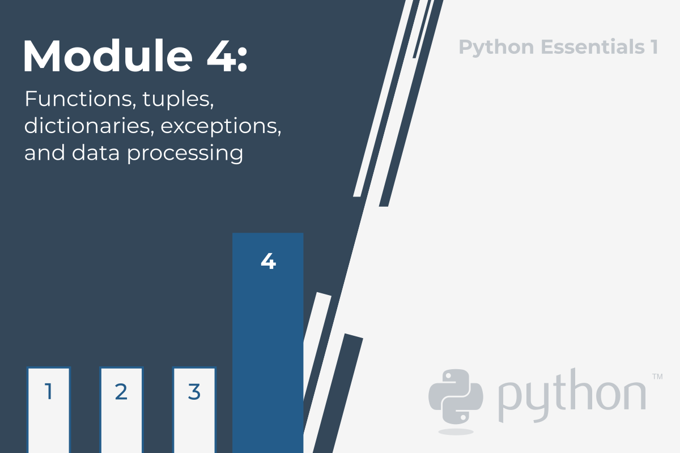

Slide 2
Python Essentials 1:
Module 4
Functions, Tuples, Dictionaries, Exceptions, and Data Processing
In this module, you will cover the following topics:
code structuring and the concept of function;
function invocation and returning a result from a function;
name scopes and variable shadowing;
tuples and their purpose, constructing and using tuples;
dictionaries and their purpose, constructing and using dictionaries;
exceptions – the try statement and the except clause, Python built-in exceptions, code testing and debugging.

Slide 3
Why do we need functions?
You've come across functions many times so far, but the view on their merits that we have given you has been rather one-sided. You've only invoked the functions by using them as tools to make life easier, and to simplify time-consuming and tedious tasks.
When you want some data to be printed on the console, you use print(). When you want to read the value of a variable, you use input(), coupled with either int() or float().
You've also made use of some methods, which are in fact functions, but declared in a very specific way.
Now you'll learn how to write your own functions, and how to use them. We'll write several functions together, from the very simple to the rather complex, which will require your focus and attention.
It often happens that a particular piece of code is repeated many times in your program. It's repeated either literally, or with only a few minor modifications, consisting of the use of other variables in the same algorithm. It also happens that a programmer cannot resist simplifying the work, and begins to clone such pieces of code using the clipboard and copy-paste operations.

Slide 4
It could end up as greatly frustrating when suddenly it turns out that there was an error in the cloned code. The programmer will have a lot of drudgery to find all the places that need corrections. There's also a high risk of the corrections causing errors.
We can now define the first condition which can help you decide when to start writing your own functions: if a particular fragment of the code begins to appear in more than one place, consider the possibility of isolating it in the form of a function invoked from the points where the original code was placed before.
It may happen that the algorithm you're going to implement is so complex that your code begins to grow in an uncontrolled manner, and suddenly you notice that you're not able to navigate through it so easily anymore.
You can try to cope with the issue by commenting the code extensively, but soon you find that this dramatically worsens your situation - too many comments make the code larger and harder to read. Some say that a well-written function should be viewed entirely in one glance.
A good and attentive developer divides the code (or more accurately: the problem) into well-isolated pieces, and encodes each of them in the form of a function.

Slide 5
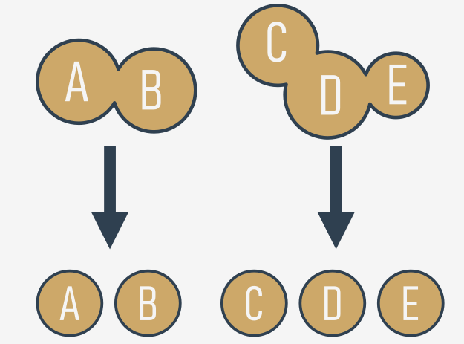
This considerably simplifies the work of the program, because each piece of code can be encoded separately, and tested separately. The process described here is often called decomposition.
We can now state the second condition: if a piece of code becomes so large that reading and understating it may cause a problem, consider dividing it into separate, smaller problems, and implement each of them in the form of a separate function.
This decomposition continues until you get a set of short functions, easy to understand and test.

Slide 6
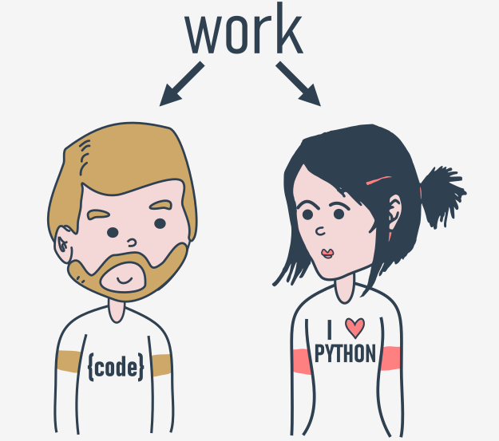
Decomposition
It often happens that the problem is so large and complex that it cannot be assigned to a single developer, and a team of developers have to work on it. The problem must be split between several developers in a way that ensures their efficient and seamless cooperation.
It seems inconceivable that more than one programmer should write the same piece of code at the same time, so the job has to be dispersed among all the team members.
This kind of decomposition has a different purpose to the one described previously - it's not only about sharing the work, but also about sharing the responsibility among many developers.
Each of them writes a clearly defined and described set of functions, which when combined into the module (we'll tell you about this a bit later) will give the final product.
This leads us directly to the third condition: if you're going to divide the work among multiple programmers, decompose the problem to allow the product to be implemented as a set of separately written functions packed together in different modules.

Slide 7
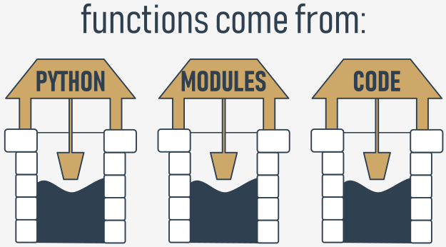
Where do the functions come from?
In general, functions come from at least three places:
from Python itself - numerous functions (like print()) are an integral part of Python, and are always available without any additional effort on behalf of the programmer; we call these functions built-in functions;
from Python's preinstalled modules - a lot of functions, very useful ones, but used significantly less often than built-in ones, are available in a number of modules installed together with Python; the use of these functions requires some additional steps from the programmer in order to make them fully accessible (we'll tell you about this in a while);
directly from your code - you can write your own functions, place them inside your code, and use them freely;
there is one other possibility, but it's connected
with classes, so we'll omit it for now.

Slide 8
Your first function
Take a look at the snippet in the editor.
It's rather simple, but we only want it to be an example of transforming a repeating part of a code into a function.
The messages sent to the console by the print() function are always the same. Of course, there's nothing really bad in such a code, but try to imagine what you would have to do if your boss asked you to change the message to make it more polite, e.g., to start it with the phrase "Please,".
It seems that you'd have to spend some time changing all the occurrences of the message (you'd use a clipboard, of course, but it wouldn't make your life much easier). It's obvious that you'd probably make some mistakes during the amendment process, and you (and your boss) would get a bit frustrated.
Is it possible to separate such a repeatable part of the code, name it and make it reusable? It would mean that a change made once in one place would be propagated to all the places where it's used.
Of course, such a code should work only when it's explicitly launched.
Yes, it's possible. This is exactly what functions are for.

Slide 9
Your first function
How do you make such a function?
You need to define it. The word define is significant here.
This is what the simplest function definition looks like:
def function_name():
function_body
It always starts with the keyword def (for define)
next after def goes the name of the function (the rules for naming functions are exactly the same as for naming variables)
after the function name, there's a place for a pair of parentheses (they contain nothing here, but that will change soon)
the line has to be ended with a colon;
the line directly after def begins the function body - a couple (at least one) of necessarily nested instructions, which will be executed every time the function is invoked; note: the function ends where the nesting ends, so you have to be careful.

Slide 10
We're ready to define our prompting function. We'll name it message - here it is:
def message():
print("Enter a value: ")
The function is extremely simple, but fully usable. We've named it message, but you can label it according to your taste. Let's use it.
Our code contains the function definition now:
def message():
print("Enter a value: ")
print("We start here.")
print("We end here.")
Note: we don't use the function at all - there's no invocation of it inside the code.

Slide 11
When you run it, you see the following output:
We start here.
We end here.
This means that Python reads the function's definitions and remembers them, but won't launch any of them without your permission.
We've modified the code now - we've inserted the function's invocation between the start and end messages:
def message():
print("Enter a value: ")
print("We start here.")
message()
print("We end here.")

Slide 12
The output looks different now:
We start here.
Enter a value:
We end here.
Test the code, modify it, experiment with it.
def say_my_name(name):
print(f'Hi {name}! How are you?')
say_my_name('Wellington')

Slide 13
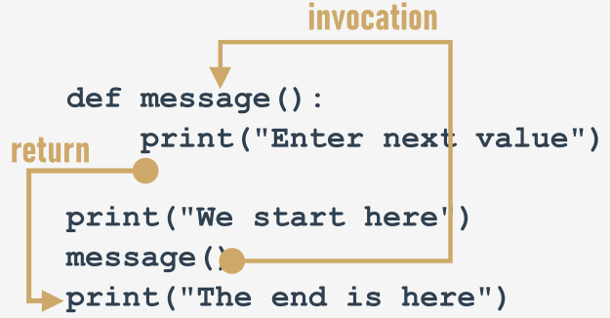
How functions work
Look at the picture below:
It tries to show you the whole process:
when you invoke a function, Python remembers the place where it happened and jumps into the invoked function;
the body of the function is then executed;
reaching the end of the function forces Python to return to the place directly after the point of invocation.

Slide 14
You mustn't invoke a function which is not known at the moment of invocation.
Remember - Python reads your code from top to bottom. It's not going to look ahead in order to find a function you forgot to put in the right place ("right" means "before invocation".)
We've inserted an error into this code - can you see the difference?
print("We start here.")
message()
print("We end here.")
def message():
print("Enter a value: ")
We've moved the function to the end of the code. Is Python able to find it when the execution reaches the invocation?
No, it isn't. The error message will read:
NameError: name 'message' is not defined

Slide 15
Don't try to force Python to look for functions you didn't deliver at the right time.
The second catch sounds a little simpler:
You mustn't have a function and a variable of the same name.
The following snippet is erroneous:
def message():
print("Enter a value: ")
message = 1
Assigning a value to the name message causes Python to forget its previous role. The function named message becomes unavailable.
Fortunately, you're free to mix your code with functions - you're not obliged to put all your functions at the top of your source file.

Slide 16
Look at the snippet:
print("We start here.")
def message():
print("Enter a value: ")
message()
print("We end here.")
It may look strange, but it's completely correct, and works as intended.

Slide 17
Let's return to our primary example, and employ the function for the right job, like here:
def message(v):
print("Enter a value: ")
print(v)
message(a)
a = int(input())
message(b)
b = int(input())
message(c)
c = int(input())
Modifying the prompting message is now easy and clear - you can do it by changing the code in just one place - inside the function's body.
Open the sandbox, and try to do it yourself.

Slide 18
Key takeaways
1. A function is a block of code that performs a specific task when the function is called (invoked). You can use functions to make your code reusable, better organized, and more readable. Functions can have parameters and return values.
2. There are at least four basic types of functions in Python:
built-in functions which are an integral part of Python (such as the print() function). You can see a complete list of Python built-in functions at https://docs.python.org/3/library/functions.html.
the ones that come from pre-installed modules (you'll learn about them in the Python Essentials 2 course)
user-defined functions which are written by users for users - you can write your own functions and use them freely in your code,
the lambda functions (you'll learn about them in the Python Essentials 2 course.)

Slide 19
3. You can define your own function using the def keyword and the following syntax:
def your_function(optional parameters):
# the body of the function
You can define a function which doesn't take any arguments, e.g.:
def message(): # defining a function
print("Hello") # body of the function
message() # calling the function
You can define a function which takes arguments, too, just like the one-parameter function below:
def hello(name): # defining a function
print("Hello,", name) # body of the function
name = input("Enter your name: ")
hello(name) # calling the function
We'll tell you more about parametrized functions in the next section. Don't worry.

Slide 20
Exercise 1
The input() function is an example of a:
a) user-defined function
b) built-in function
Exercise 2
What happens when you try to invoke a function before you define it? Example:
hi()
def hi():
print("hi!") # An exception is thrown (the NameError exception to be more precise)
Exercise 3
What will happen when you run the code below?
def hi():
print("hi")
hi(5) # An exception will be thrown (the TypeError exception to be more precise) - the hi() function doesn't take any arguments

Slide 21
Parameterized functions
The function's full power reveals itself when it can be equipped with an interface that is able to accept data provided by the invoker. Such data can modify the function's behavior, making it more flexible and adaptable to changing conditions.
A parameter is actually a variable, but there are two important factors that make parameters different and special:
parameters exist only inside functions in which they have been defined, and the only place where the parameter can be defined is a space between a pair of parentheses in the def statement;
assigning a value to the parameter is done at the time of the function's invocation, by specifying the corresponding argument.
def function(parameter):
###

Slide 22
Don't forget:
parameters live inside functions (this is their natural environment)
arguments exist outside functions, and are carriers of values passed to corresponding parameters.
There is a clear and unambiguous frontier between these two worlds.
Let's enrich the function above with just one parameter - we're going to use it to show the user the number of a value the function asks for.
We have to rebuild the def statement - this is how it looks now:
def message(number):
###
The definition specifies that our function operates on just one parameter named number. You can use it as an ordinary variable, but only inside the function - it isn't visible anywhere else.

Slide 23
Let's now improve the function's body:
def message(number):
print("Enter a number:", number)
We've made use of the parameter. Note: we haven't assigned the parameter with any value. Is it correct?
Yes, it is.
A value for the parameter will arrive from the function's environment.
Remember: specifying one or more parameters in a function's definition is also a requirement, and you have to fulfil it during invocation. You must provide as many arguments as there are defined parameters.
Failure to do so will cause an error.

Slide 24
Parametrized functions: continued
Try to run the code in the editor.
This is what you'll see in the console:
def message(number):
print("Enter a number:", number)
message() # missing argument
TypeError: message() missing 1 required positional argument: 'number'
This looks better, for sure:
def message(number):
print("Enter a number:", number)
message(1)

Slide 25
Moreover, it behaves better. The code will produce the following output:
Enter a number: 1
Can you see how it works? The value of the argument used during invocation (1) has been passed into the function, setting the initial value of the parameter named number.
We have to make you sensitive to one important circumstance.
It's legal, and possible, to have a variable named the same as a function's parameter.
The snippet illustrates the phenomenon:
def message(number):
print("Enter a number:", number)
number = 1234
message(1)
print(number)

Slide 26
A situation like this activates a mechanism called shadowing:
parameter x shadows any variable of the same name, but...
... only inside the function defining the parameter.
The parameter named number is a completely different entity from the variable named number.
This means that the snippet above will produce the following output:
Enter a number: 1 # from the function
1234 # from the variable

Slide 27
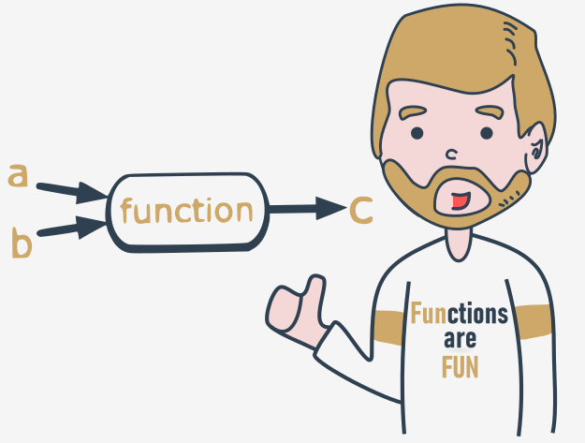
Parametrized functions: continued
A function can have as many parameters as you want, but the more parameters you have, the harder it is to memorize their roles and purposes.
Let's modify the function - it has two parameters now:
def message(what, number):
print("Enter", what, "number", number)
This also means that invoking the function will require two arguments.
The first new parameter is intended to carry the name of the desired value.
Here it is:
def message(what, number):
print("Enter", what, "number", number)
message("telephone", 11)
message("price", 5)
message(“your name”, “and see your lock number!”)
Run the code, modify it, add more parameters, and see how this affects the output.
This is the output you're about to see:
Enter telephone number 11
Enter price number 5
Enter number number number

Slide 28
Positional parameter passing
A technique which assigns the i^{th} (first, second, and so on) argument to the i^{th} (first, second, and so on) function parameter is called positional parameter passing, while arguments passed in this way are named positional arguments.
You've used it already, but Python can offer a lot more. We're going to tell you about it now.
def my_function(a, b, c):
print(a, b, c)
my_function(1, 2, 3)
Note: positional parameter passing is intuitively used by people in many social occasions. For example, it may be generally accepted that when we introduce ourselves we mention our first name(s) before our last name, e.g., "My name's John Doe."
Incidentally, Hungarians do it in reverse order.

Slide 29
Let's implement that social custom in Python. The following function will be responsible for introducing somebody:
def introduction(first_name, last_name):
print("Hello, my name is", first_name, last_name)
introduction("Luke", "Skywalker")
introduction("Jesse", "Quick")
introduction("Clark", "Kent")
Can you guess the output? Run the code and find out if you were right.
Now imagine that the same function is being used in Hungary. In this case, the code would look like this:
def introduction(first_name, last_name):
print("Hello, my name is", first_name, last_name)
introduction("Skywalker", "Luke")
introduction("Quick", "Jesse")
introduction("Kent", "Clark")

Slide 30
The output will look different. Can you guess it?
Run the code to see if you were right here, too. Are you surprised?
Can you make the function more culture-independent?

Slide 31
Keyword argument passing
Python offers another convention for passing arguments, where the meaning of the argument is dictated by its name, not by its position - it's called keyword argument passing.
Take a look at the snippet:
def introduction(first_name, last_name):
print("Hello, my name is", first_name, last_name)
introduction(first_name = "James", last_name = "Bond")
introduction(last_name = "Skywalker", first_name = "Luke")
The concept is clear - the values passed to the parameters are preceded by the target parameters' names, followed by the = sign.
The position doesn't matter here - each argument's value knows its destination on the basis of the name used.
You should be able to predict the output. Run the code to check if you were right.

Slide 32
Of course, you mustn't use a non-existent parameter name.
The following snippet will cause a runtime error:
def introduction(first_name, last_name):
print("Hello, my name is", first_name, last_name)
introduction(surname="Skywalker", first_name="Luke")
This is what Python will tell you:
TypeError: introduction() got an unexpected keyword argument 'surname'
Try it out yourself.

Slide 33
Mixing positional and keyword arguments
You can mix both fashions if you want - there is only one unbreakable rule: you have to put positional arguments before keyword arguments.
If you think for a moment, you'll certainly guess why.
To show you how it works, we'll use the following simple three-parameter function:
def adding(a, b, c):
print(a, "+", b, "+", c, "=", a + b + c)
Its purpose is to evaluate and present the sum of all its arguments.
The function, when invoked in the following way:
adding(1, 2, 3)
will output:
1 + 2 + 3 = 6

Slide 34
It was - as you may suspect - a pure example of positional argument passing.
Of course, you can replace such an invocation with a purely keyword variant, like this:
adding(c = 1, a = 2, b = 3)
Our program will output a line like this:
2 + 3 + 1 = 6
Note the order of the values.
Let's try to mix both styles now.
Look at the function invocation below:
adding(3, c = 1, b = 2)

Slide 35
Let's analyze it:
the argument (3) for the a parameter is passed using the positional way;
the arguments for c and b are specified as keyword ones.
This is what you'll see in the console:
3 + 2 + 1 = 6
Be careful, and beware of mistakes. If you try to pass more than one value to one argument, all you'll get is a runtime error.
Look at the invocation below - it seems that we've tried to set a twice:
adding(3, a = 1, b = 2)
Python's response:
TypeError: adding() got multiple values for argument 'a'

Slide 36
Look at the snipet below. A code like this is fully correct, but it doesn't make much sense:
adding(4, 3, c = 2)
Everything is right, but leaving in just one keyword argument looks a bit weird - what do you think?

Slide 37
Parametrized functions - more details
It happens at times that a particular parameter's values are in use more often than others. Such arguments may have their default (predefined) values taken into consideration when their corresponding arguments have been omitted.
They say that the most popular English last name is Smith. Let's try to take this into account.
The default parameter's value is set using clear and pictorial syntax:
def introduction(first_name, last_name="Smith"):
print("Hello, my name is", first_name, last_name)
You only have to extend the parameter's name with the = sign, followed by the default value.
Let's invoke the function as usual:
introduction("James", "Doe")

Slide 38
Can you guess the output of the program? Run it and check if you were right.
And? Everything looks the same, but when you invoke the function in a way that looks a bit suspicious at first sight, like this:
introduction("Henry")
or this:
introduction(first_name="William")
there will be no error, and both invocations will succeed, while the console will show the following output:
Hello, my name is Henry Smith
Hello, my name is William Smith
Test it.

Slide 39
You can go further if it's useful. Both parameters have their default values now, look at the code below:
def introduction(first_name="John", last_name="Smith"):
print("Hello, my name is", first_name, last_name)
This makes the following invocation absolutely valid:
introduction() # No arguments
And this is the expected output:
Hello, my name is John Smith
If you use one keyword argument, the remaining one will take the default value:
introduction(last_name="Hopkins")
The output is:
Hello, my name is John Hopkins
Test it.
Congratulations - you have just learned the basic ways of communicating with functions.

Slide 40
Key takeaways
1. You can pass information to functions by using parameters. Your functions can have as many parameters as you need.
An example of a one-parameter function:
def hi(name):
print("Hi,", name)
hi("Greg")
An example of a two-parameter function:
def hi_all(name_1, name_2):
print("Hi,", name_2)
print("Hi,", name_1)
hi_all("Sebastian", "Konrad")

Slide 41
An example of a three-parameter function:
def address(street, city, postal_code):
print("Your address is:", street, "St.,", city, postal_code)
s = input("Street: ")
p_c = input("Postal Code: ")
c = input("City: ")
address(s, c, p_c)
2. You can pass arguments to a function using the following techniques:
positional argument passing in which the order of arguments passed matters (Ex. 1),
keyword (named) argument passing in which the order of arguments passed doesn't matter (Ex. 2),
a mix of positional and keyword argument passing (Ex. 3).

Slide 42
Ex. 1
def subtra(a, b):
print(a - b)
subtra(5, 2) # outputs: 3
subtra(2, 5) # outputs: -3
Ex. 2
def subtra(a, b):
print(a - b)
subtra(a=5, b=2) # outputs: 3
subtra(b=2, a=5) # outputs: 3
Ex. 3
def subtra(a, b):
print(a - b)
subtra(5, b=2) # outputs: 3
subtra(5, 2) # outputs: 3

Slide 43
It's important to remember that positional arguments mustn't follow keyword arguments. That's why if you try to run the following snippet:
def subtra(a, b):
print(a - b)
subtra(5, b=2) # outputs: 3
subtra(a=5, 2) # Syntax Error
Python will not let you do it by signalling a SyntaxError.
3. You can use the keyword argument passing technique to pre-define a value for a given argument:
def name(first_name, last_name="Smith"):
print(first_name, last_name)
name("Andy") # outputs: Andy Smith
name("Betty", "Johnson") # outputs: Betty Johnson (the keyword argument replaced by "Johnson")

Slide 44
Exercise 1
What is the output of the following snippet?
def intro(a="James Bond", b="Bond"):
print("My name is", b + ".", a + ".")
intro() # My name is Bond. James Bond.
Exercise 2
What is the output of the following snippet?
def intro(a="James Bond", b="Bond"):
print("My name is", b + ".", a + ".")
intro(b="Sean Connery") # My name is Sean Connery. James Bond.

Slide 45
Exercise 3
What is the output of the following snippet?
def intro(a, b="Bond"):
print("My name is", b + ".", a + ".")
intro("Susan") # My name is Bond. Susan.
Exercise 4
What is the output of the following snippet?
def add_numbers(a, b=2, c):
print(a + b + c)
add_numbers(a=1, c=3) # SyntaxError - a non-default argument (c) follows a default argument (b=2)

